Slide 1
REFRACTIVE ERROR AND LOW VISION
PROF. T. ADE

Slide 2
Emmetropia (optically normal eye) can be defined as a state of refraction, where in the parallel rays of light coming from infinity are focused at the sensitive layer of retina with the accommodation being at rest

Slide 3
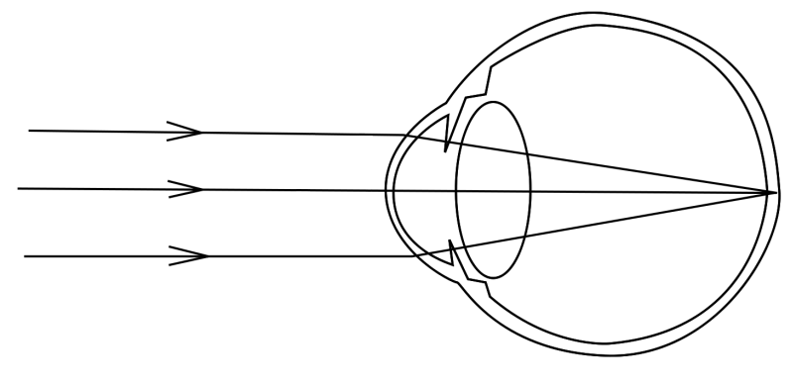

Slide 4
At birth, the eyeball is relatively short, having +2 to +3 hypermetropia.
This is gradually reduced until by the age of 5-7 years the eye is emmetropic and remains so till the age of about 50 years.

Slide 5
After this, there is tendency to develop hypermetropia again, which gradually increases until at the extreme of life the eye has the same +2 to +3 with which it started.
This senile hypermetropia is due to changes in the crystalline lens.

Slide 6
Ametropia (a condition of refractive error), is defined as a state of refraction, when the parallel rays of light coming from infinity (with accommodation at rest), are focused either in front or behind the sensitive layer of retina, in one or both the meridians.
The ametropia includes myopia, hypermetropia and astigmatism.

Slide 7
HYPERMETROPIA
Hypermetropia (hyperopia) or long-sightedness is the refractive state of the eye wherein parallel rays of light coming from infinity are focused behind the retina with accommodation being at rest.
Thus, the posterior focal point is behind the retina, which therefore receives a blurred image.

Slide 8
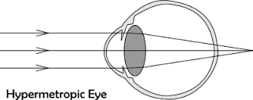

Slide 9
Etiology
Hypermetropia may be axial, curvatural, index, positional and due to absence of lens.
1. Axial hypermetropia is by far the commonest form.
In this condition the total refractive power of eye is normal but there is an axial shortening of eyeball.
About 1–mm shortening of the anteroposterior diameter of the eye results in 3 dioptres of hypermetropia.

Slide 10
2. Curvatural hypermetropia is the condition in which the curvature of cornea, lens or both is flatter than the normal resulting in a decrease in the refractive power of eye.
About 1 mm increase in radius of curvature results in 6 dioptres of hypermetropia.

Slide 11
3. Index hypermetropia occurs due to decrease in refractive index of the lens in old age.
It may also occur in diabetics under treatment.
4. Positional hypermetropia results from posteriorly placed crystalline lens

Slide 12
5. Absence of crystalline lens either congenitally or acquired (following surgical removal or posterior dislocation) leads to aphakia — a condition of high hypermetropia

Slide 13
Clinical picture
Symptoms:
In patients with hypermetropia the symptoms vary depending upon the age of patient and the degree of refractive error.
These can be grouped as under:
1. Asymptomatic. A small amount of refractive error in young patients is usually corrected by mild accommodative effort without producing any symptom.

Slide 14
2. Asthenopic symptoms. At times the hypermetropia is fully corrected (thus vision is normal) but due to sustained accommodative efforts patient develops asthenopic sysmtoms.
These include: tiredness of eyes, frontal or fronto-temporal headache, watering and mild photophobia.
These asthenopic symptoms are especially associated with near work and increase towards evening

Slide 15
3. Defective vision with asthenopic symptoms.
When the amount of hypermetropia is such that it is not fully corrected by the voluntary accommodative efforts, then the patients complain of defective vision which is more for near than distance and is associated with asthenopic symptoms due to sustained accommodative efforts.

Slide 16
4. Defective vision only.
When the amount of hypermetropia is very high, the patients usually do not accommodate (especially adults) and there occurs marked defective vision for near and distance.

Slide 17
Signs
1. Size of eyeball may appear small as a whole.
2. Cornea may be slightly smaller than the normal.
3. Anterior chamber is comparatively shallow.

Slide 18
4. Fundus examination reveals a small optic disc which may look more vascular with ill-defined margins and even may simulate papillitis (though there is no swelling of the disc, and so it is called pseudopapillitis).
The retina as a whole may shine due to greater brilliance of light reflections (shot silk appearance).

Slide 19
5. A-scan ultrasonography (biometry) may reveal a short antero-posterior length of the eyeball.

Slide 20
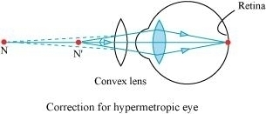
Treatment
Optical treatment. Basic principle of treatment is to prescribe convex (plus) lenses, so that the light rays are brought to focus on the retina.

Slide 21
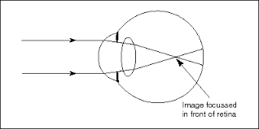
MYOPIA
Myopia or short-sightedness is a type of refractive error in which parallel rays of light coming from infinity are focused in front of the retina when accommodation is at rest.

Slide 22
Etiological classification
1. Axial myopia results from increase in anteroposterior length of the eyeball. It is the commonest form.
2. Curvatural myopia occurs due to increased curvature of the cornea, lens or both

Slide 23
3. Positional myopia is produced by anterior placement of crystalline lens in the eye.
4. Index myopia results from increase in the refractive index of crystalline lens associated with nuclear sclerosis.
5. Myopia due to excessive accommodation occurs in patients with spasm of accommodation.

Slide 24
Clinical picture
Symptoms
Poor vision for distance (short-sightedness) is the main symptom of myopia.
Asthenopic symptoms may occur in patients with small degree of myopia.
.

Slide 25
Half shutting of the eyes may be complained by parents of the child.
The child does so to achieve the greater clarity of stenopaeic vision

Slide 26
Signs
Prominent eyeballs.
The myopic eyes typically are large and somewhat prominent.
Anterior chamber is slightly deeper than normal.
Pupils are somewhat large and a bit sluggishly reacting.

Slide 27
Fundus is normal; rarely temporal myopic crescent may be seen.
Magnitude of refractive error: Simple myopia usually occur between 5 and 10 year of age and it keeps on increasing till about 18-20 years of age at a rate of about –0.5 ± 0.30 every year.
In simple myopia, usually the error does not exceed 6 to 8.

Slide 28
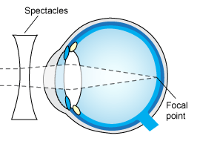
Treatment of myopia
Optical treatment of myopia constitutes prescription of appropriate concave lenses, so
that clear image is formed on the retina

Slide 29
ASTIGMATISM
Astigmatism is a type of refractive error wherein the refraction varies in the different meridia.
Consequently, the rays of light entering in the eye cannot converge to a point focus but form focal lines.
Broadly, there are two types of astigmatism: regular and irregular

Slide 30
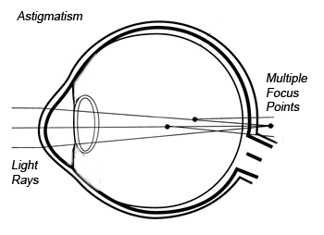

Slide 31
Etiology
1. Corneal astigmatism is the result of abnormalities of curvature of cornea. It constitutes the most common cause of astigmatism.
2. Lenticular astigmatism is rare. It may be:
i. Curvatural due to abnormalities of curvature of lens as seen in lenticonus.

Slide 32
ii. Positional due to tilting or oblique placement of lens as seen in subluxation.
iii. Index astigmatism may occur rarely due to variable refractive index of lens in different meridia.
3. Retinal astigmatism due to oblique placement of macula may also be seen occasionally.

Slide 33
Clinical Pictures
Symptoms
Symptoms of regular astigmatism include:
(i) defective vision;
(ii) blurring of objects;
(iii) depending upon the type and degree of astigmatism, objects may appear proportionately elongated;

Slide 34
(iv) asthenopic symptoms, which are marked especially in small amount of astigmatism, consist of a dull ache in the eyes, headache, early tiredness of eyes and sometimes nausea and even drowsiness.

Slide 35
Signs
1. Different power in two meridia is revealed on retinoscopy or autorefractometry.
2. Oval or tilted optic disc may be seen on ophthalmoscopy in patients with high degree of astigmatism.

Slide 36
3. Head tilt. The astigmatic patients may (very exceptionally) develop a torticollis in an attempt to bring their axes nearer to the horizontal or vertical meridians.
4. Half closure of the lid. Like myopes, the astigmatic patients may half shut the eyes to achieve the greater clarity of stenopaeic vision.

Slide 37
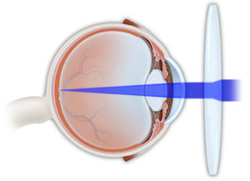
Treatment
1. Optical treatment of regular astigmatism comprises the prescribing appropriate cylindrical lens, discovered after accurate refraction

Slide 38
PRESBYOPIA
This is the gradual loss of accommodative response resulting from reduced elasticity of the crystalline lens.
Accommodative amplitude diminishes with age.

Slide 39
It becomes a clinical problem when the remaining accommodative amplitude is insufficient for the patient to read and carry out near vision tasks.
Presbyopia usually begins in a patient aged 40 years.
Patient has symptoms of asthenopia as well

Slide 40

TREATMENT
Appropriate convex lenses can compensate for the waning of accommodative power

Slide 41
LOW VISION
Low vision is the term used to refer to a visual impairment that is not correctable through surgery, pharmaceuticals, glasses or contact lenses.
It is often characterized by partial sight, such as blurred vision, blind spots or tunnel vision, but also includes legal blindness.

Slide 42
Causes of Low Vision
Low vision can be caused by eye diseases, such as macular degeneration, glaucoma, diabetic retinopathy and retinitis pigmentosa. It can also be caused by eye injuries.
These conditions can occur at any age but are more common in older people.
However, normal aging of the eye does not lead to low vision.

Slide 43
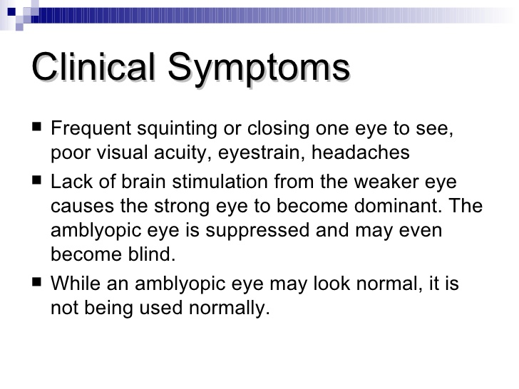

Slide 44
Treatment of low vision
Though lost vision cannot be restored, a combination of vision training, rehabilitation and low vision devices can provide independence and an increased quality of life.
The key is working in tandem with a low vision specialist.

Slide 45
Other professionals, such as social workers, instructors, technicians and therapists, can also play a part in restoring independence.
With proper training, some people can even learn to drive while wearing their low vision devices.

Slide 46
Low Vision Aids are tools that help those with vision loss maximize their remaining vision and these devices fall into one of three broad categories:
Optical devices.
Electronic devices.
Non-optical devices.

Slide 47
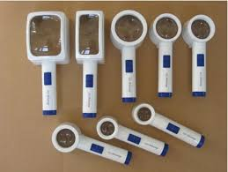
Optical Device

Slide 48
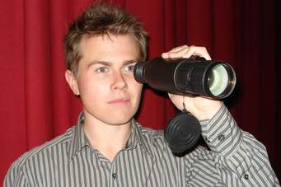
Optical Device

Slide 49

Non Optical Device

Slide 50
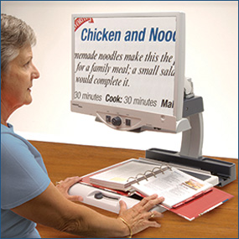
Electronic Device

